Slide 1
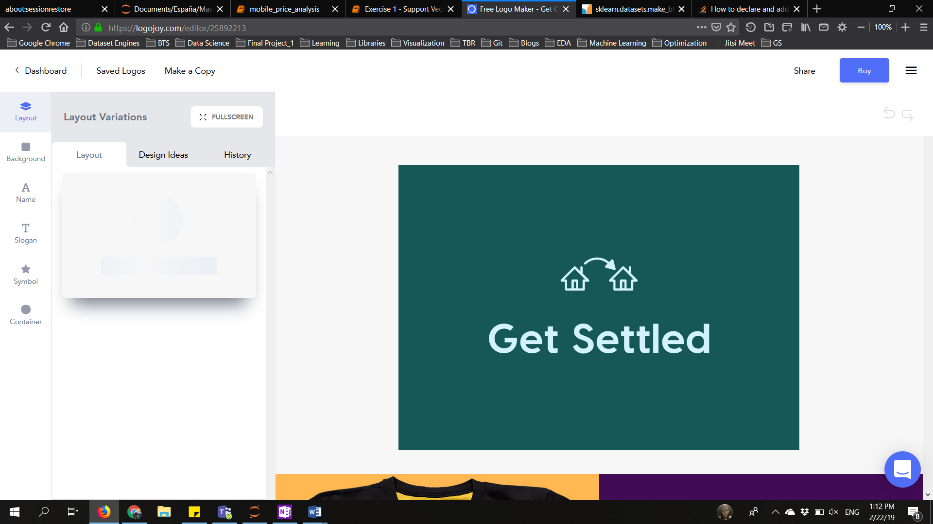

Slide 2
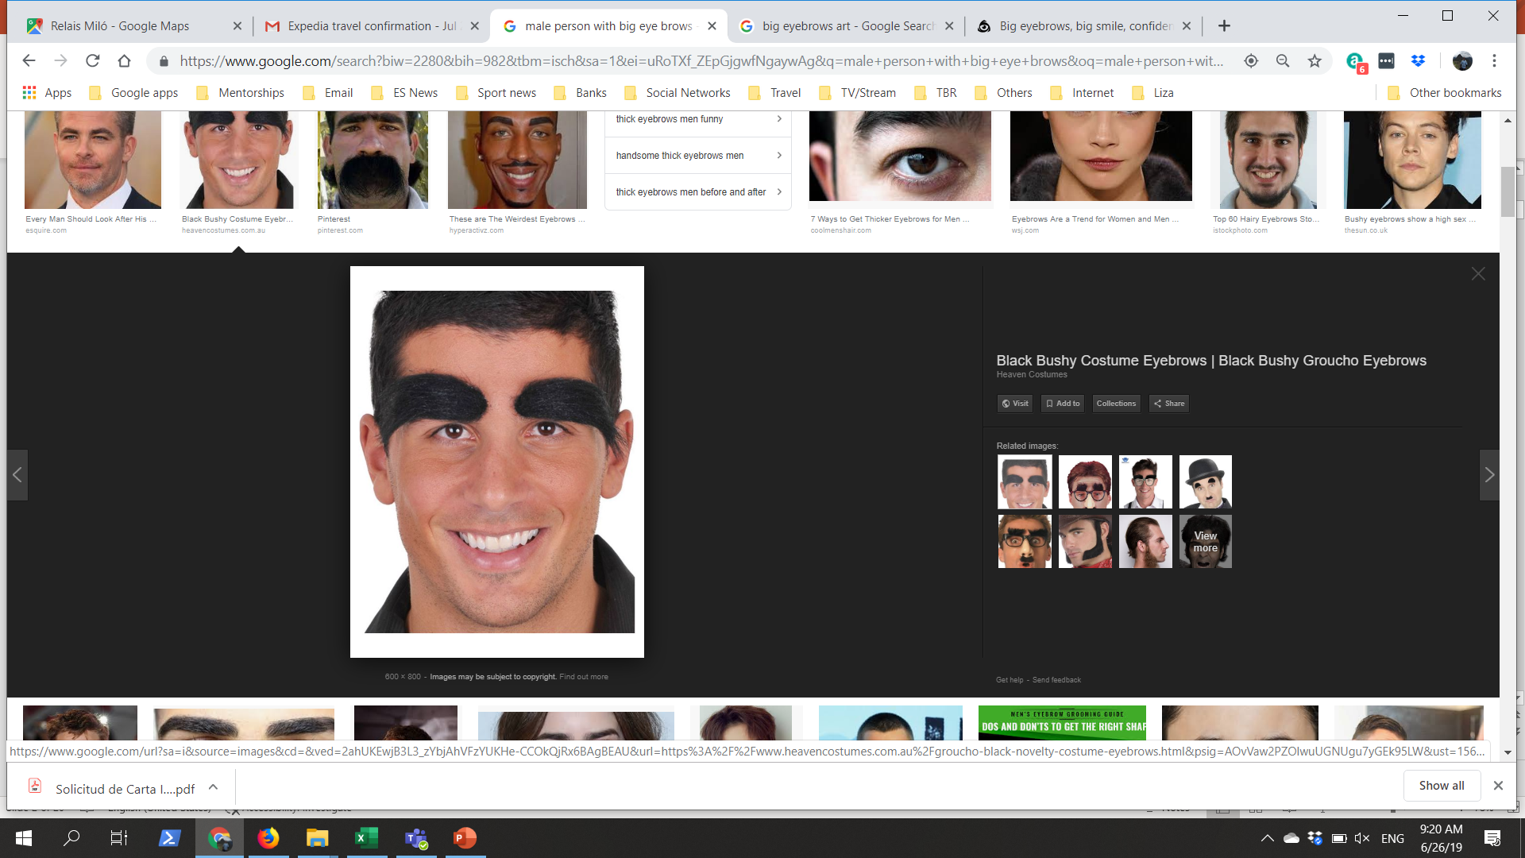
C
Felipe:
26 years old
Ecuador
Accepted for a Big Data masters in Barcelona Technology School.
1 month away from arriving in BCN

Slide 3
C
Why is Felipe Worried?
He will have to wait for a long time after arriving in Barcelona to get a flat.
Will have hard time establishing routine that will help him adapt faster to the new living style.
Will take a long time getting necessary living services.
And he doesn’t know enough about the neighborhoods in Barcelona to take a decision from home.

Slide 4
C
Felipe found that:
70% of the students used apps that connected them to flat owners.
60% of students were without a long-term lease when they arrived in Barcelona.
80% began looking for a flat to live in, at least 1 month before arriving in Barcelona.
20% of students took more than 2 months to get a LT lease after arriving in Barcelona.

Slide 5
C
Felipe also finds that:
To connect students to the living space that best adapts to their way of life, enabling them to settle in faster in Barcelona.

Slide 6
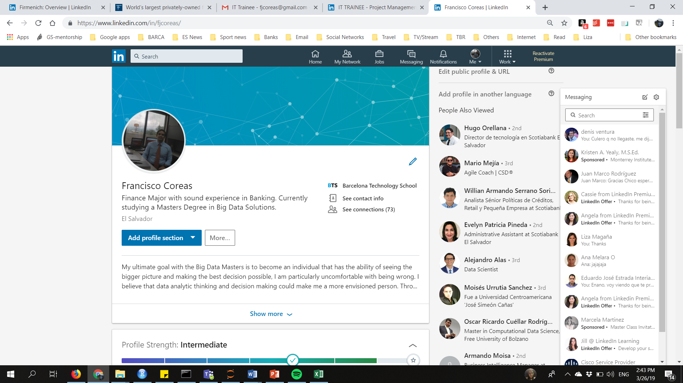
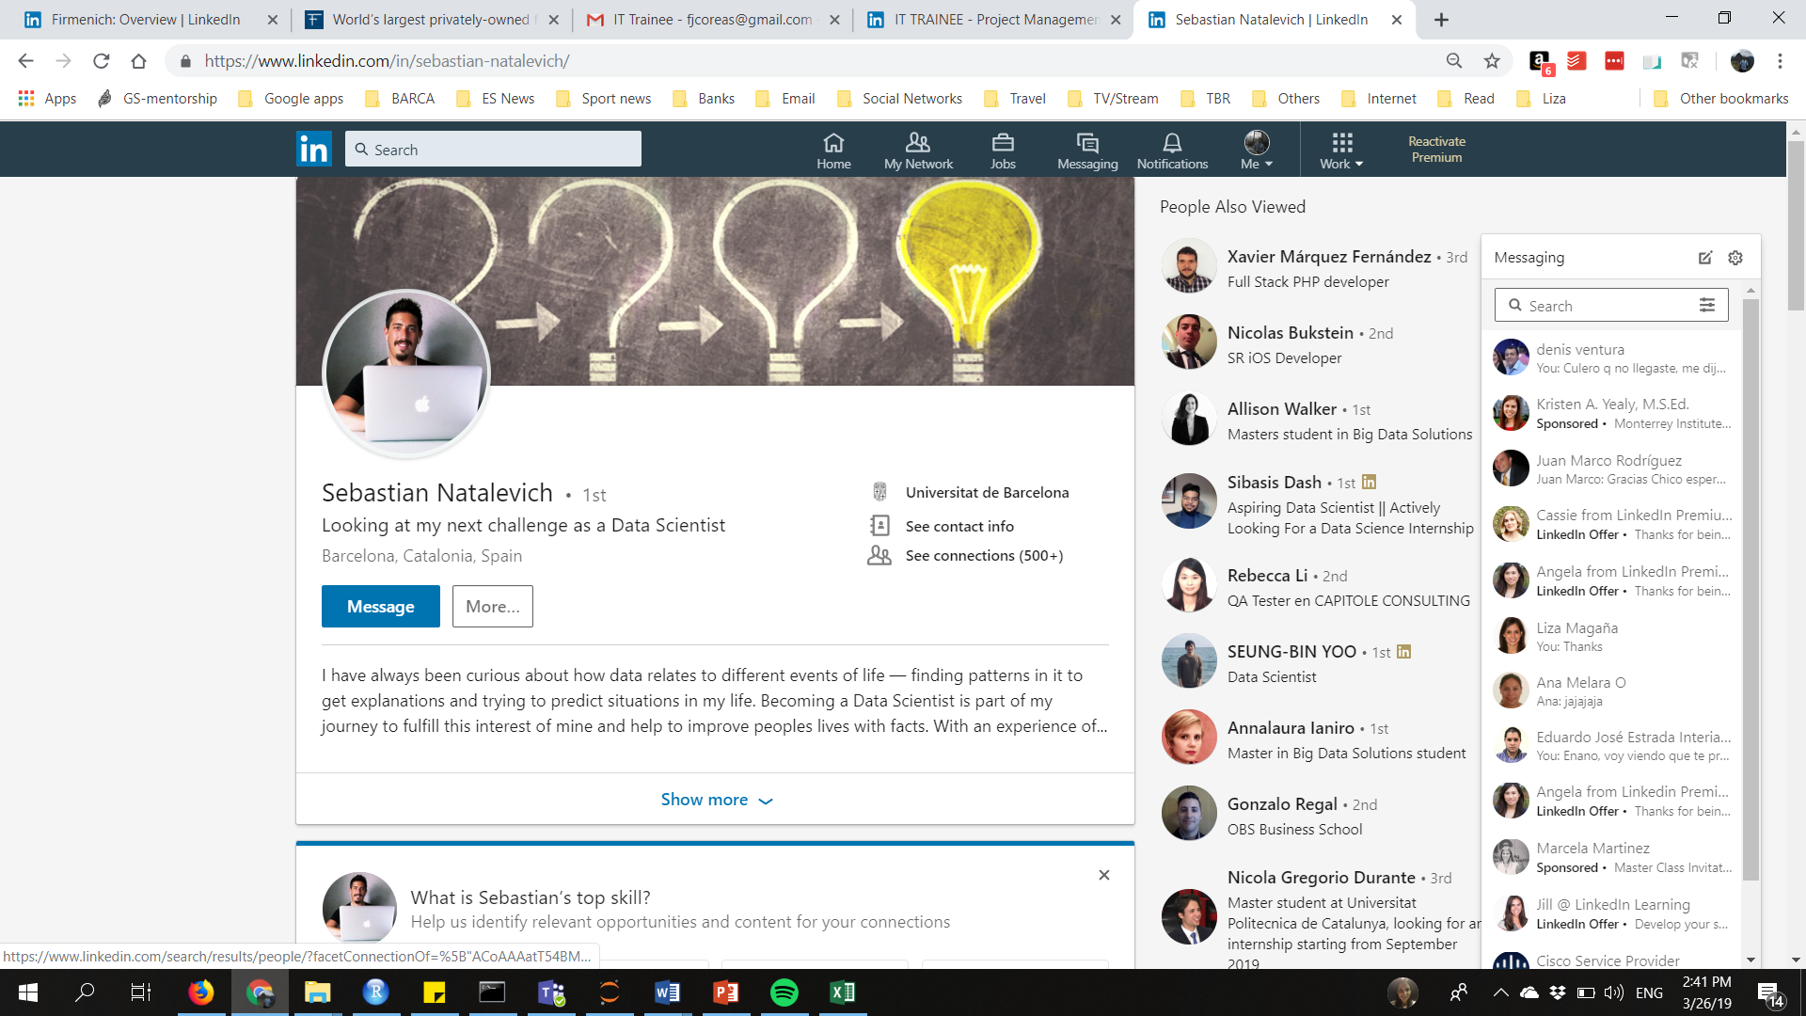
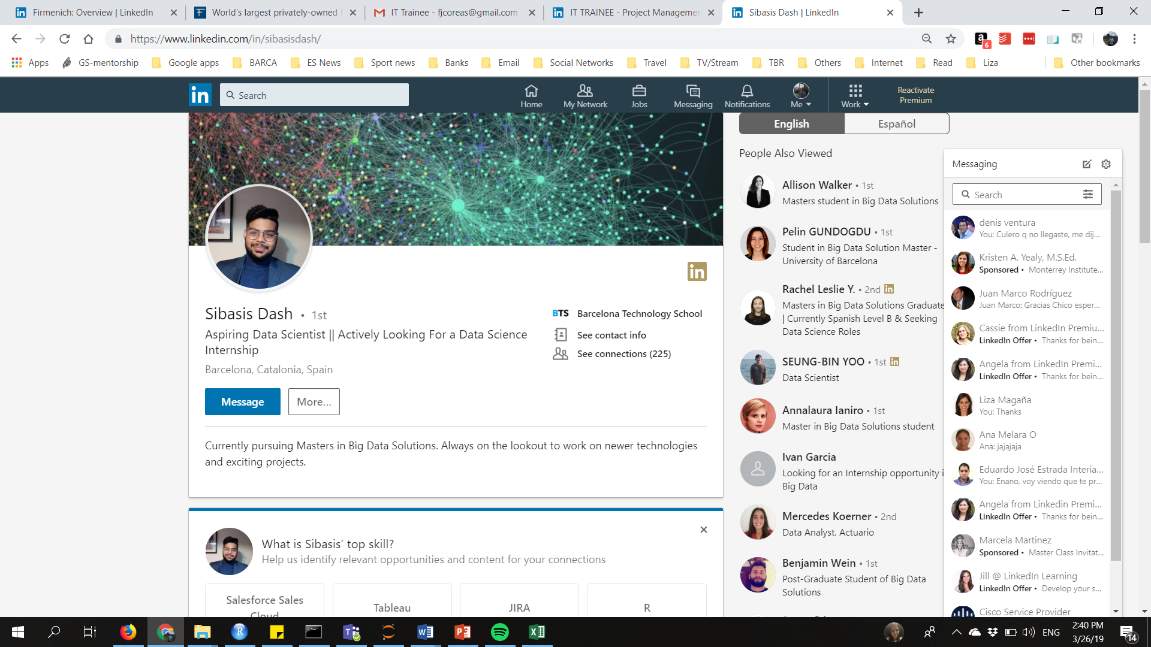
C
Team:
Co Founder / VP Engineering:
IOs specialist and developer with experience working as Mobile Head for Hello Hart.
Co Founder / VP Sales & Marketing:
Financial and Business specialist, with experience as Senior Manager in Scotiabank.
Co Founder / CEO:
Data science specialist, previous experience as a Database Analyst in Accenture.

Slide 7
C
The Solution:
We combine neighborhood rankings with user preferences to suggest users the best fitted flats.

Slide 8
Si
Neighborhood Rankings:
Ranking of neighborhoods where you have more opportunities of finding a flat/room in your budget. (Price Ranking)
Ranking of neighborhoods that are within a certain commute time from a point of interest. (POI Ranking)
Ranking of neighborhoods that are safer in terms of incidents per habitants (Security Ranking).

Slide 9
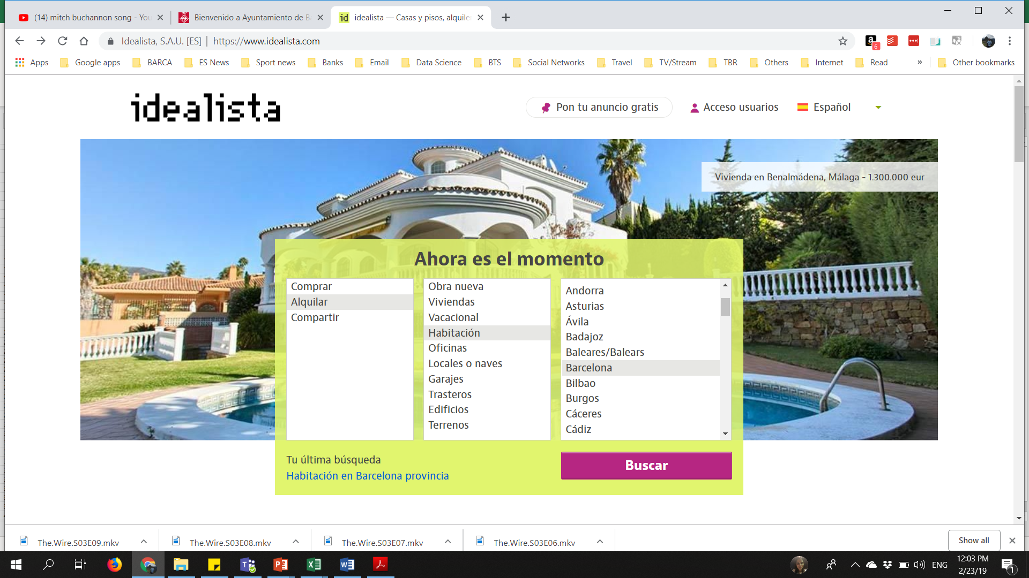
Se
Price Ranking:
Connection to an API from Idealista.
Data stored in internal database.
User’s inputs - price range and type of accommodation.
Count the houses per neighborhood.
Ranking based on house count per neighborhood that is within the price range.

Slide 10
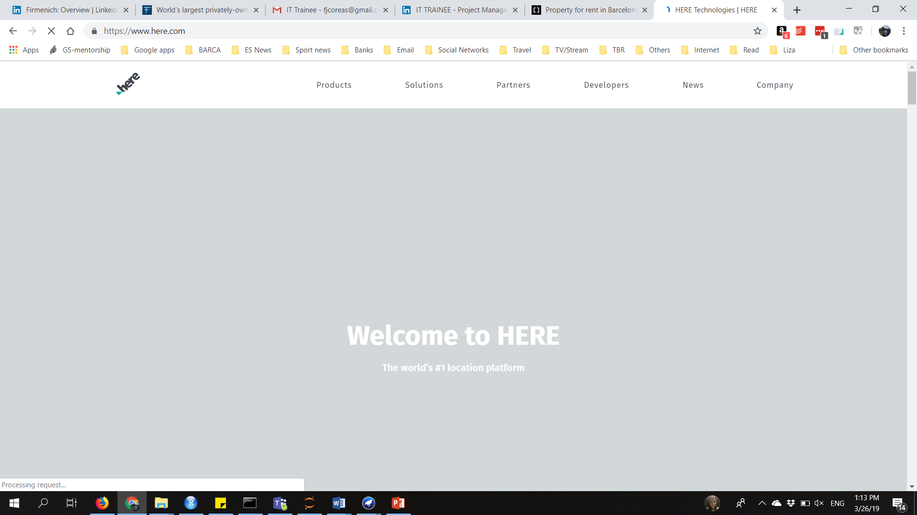

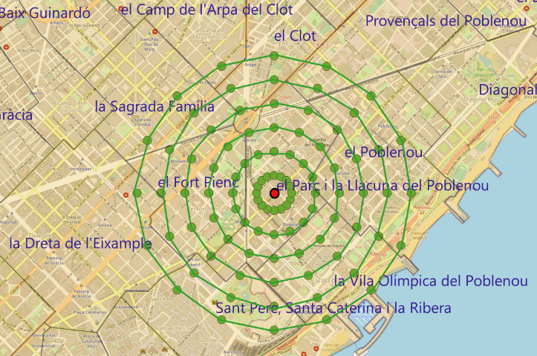
Se
POI Ranking:
We use street and number provided by user and desired commute time.
Assumption: People walk at an average of 5 km/hr.
User importance = 120 meters
300 meter distance between circles
16 points in each circle

Slide 11
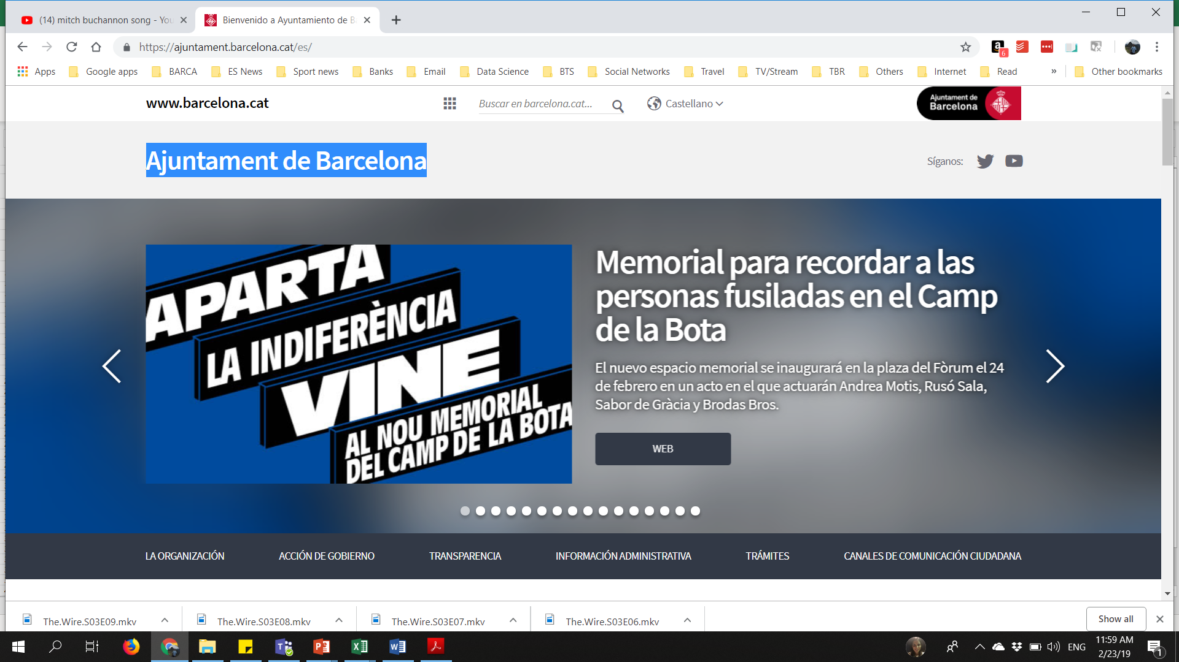
Si
Security Ranking :
The Datasets were obtained from the Adjuntamiento de Barcelona archives.
The incidents were categorized as per their severity: Low Risk (1), Medium Risk(10) & High Risk(100).
The score obtained was incidents occurring per 100 persons in a particular neighborhood. (Bias elimination)

Slide 12

Si
Pointing System:
User must assign 9 points between: Security, Price & POI ,allocating at least 1 point to each.
The algorithm works as per user preference, giving more importance to the feature getting more points.

Slide 13
Se
Final Ranking:
POI and Budget ranking help filter out unimportant neighborhoods.
Normalization of scores in each of the categories for summing up to obtain final ranking.
Integration of user preferences. (9 points)

Slide 14
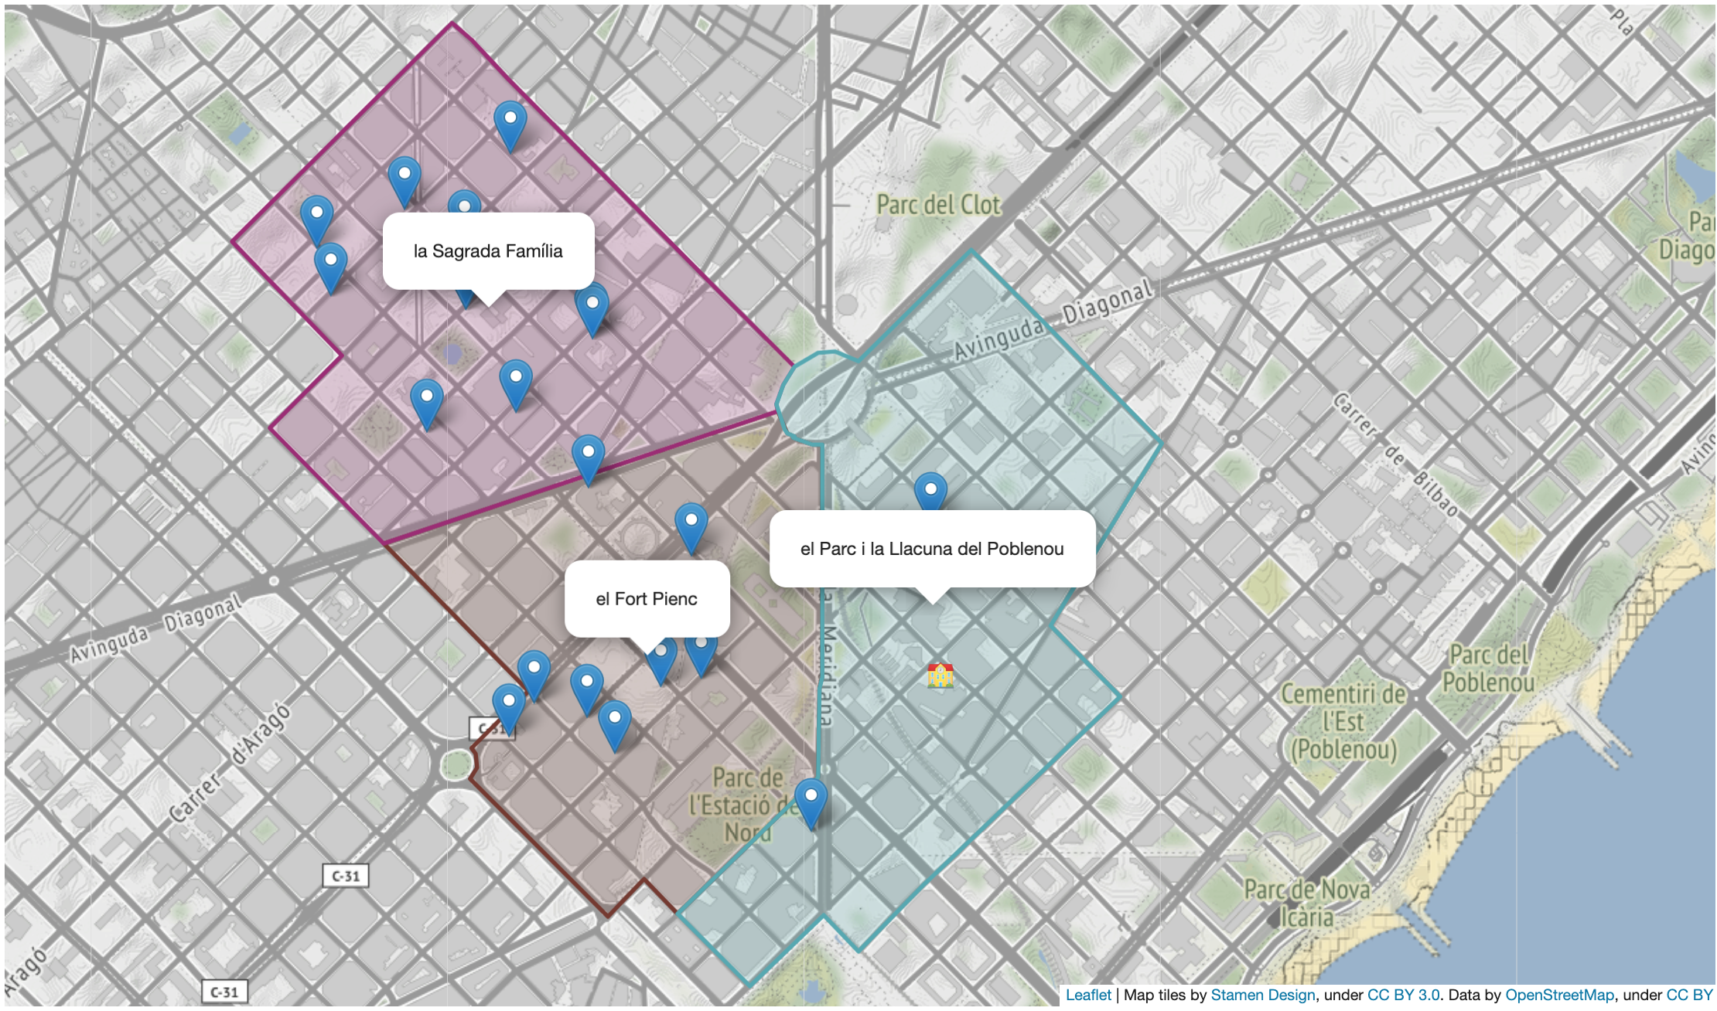
Se
Visualization:
Telluric library from Satellogic.
Image of the flat/room and link.

Slide 15
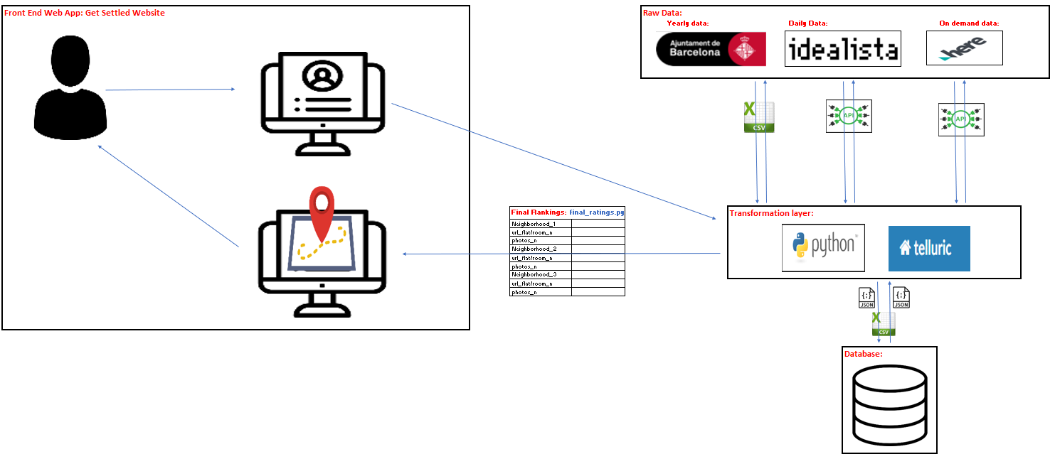
C
Data Infrastructure:

Slide 16
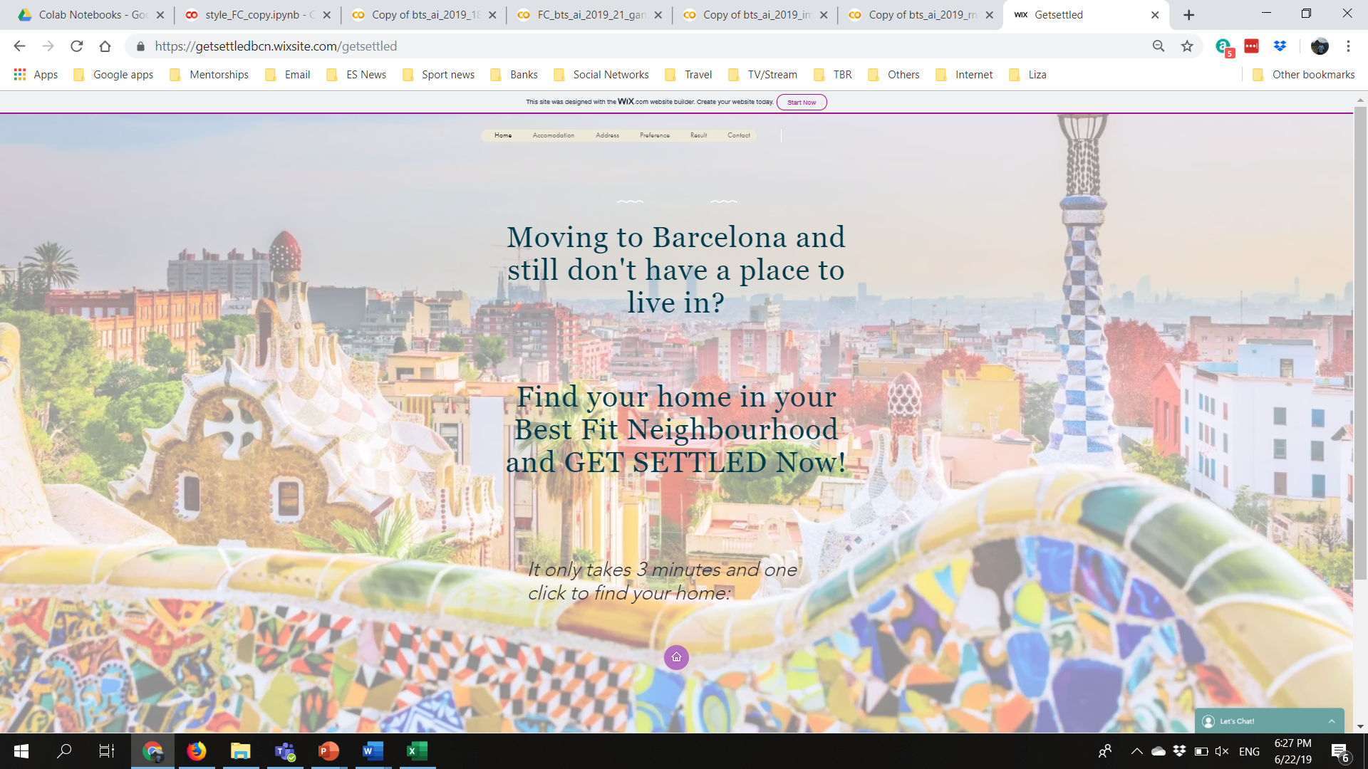
Si
Website design 1:

Slide 17
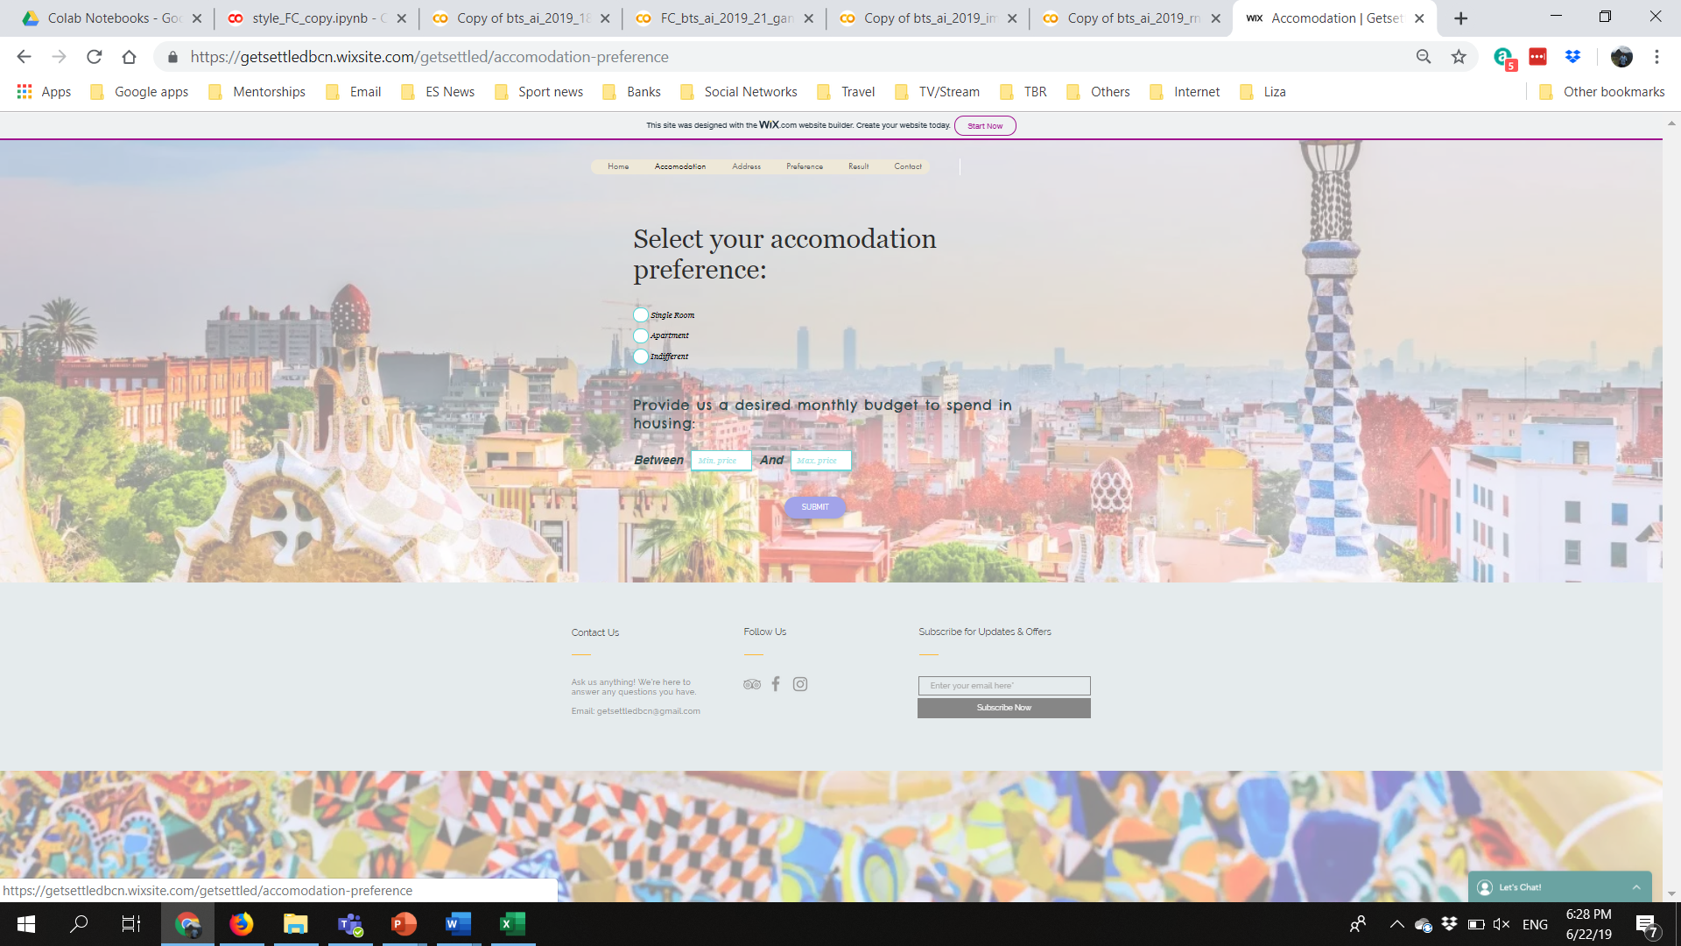
Si
Website design 2:

Slide 18
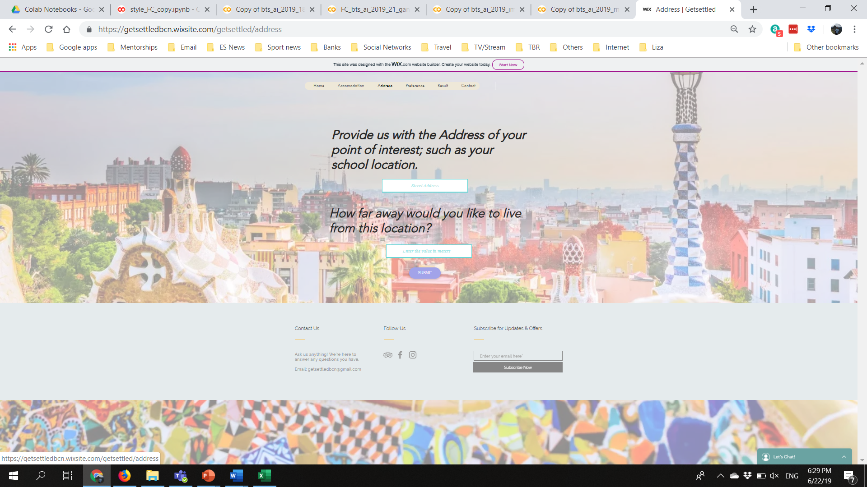
Si
Website design 3:

Slide 19
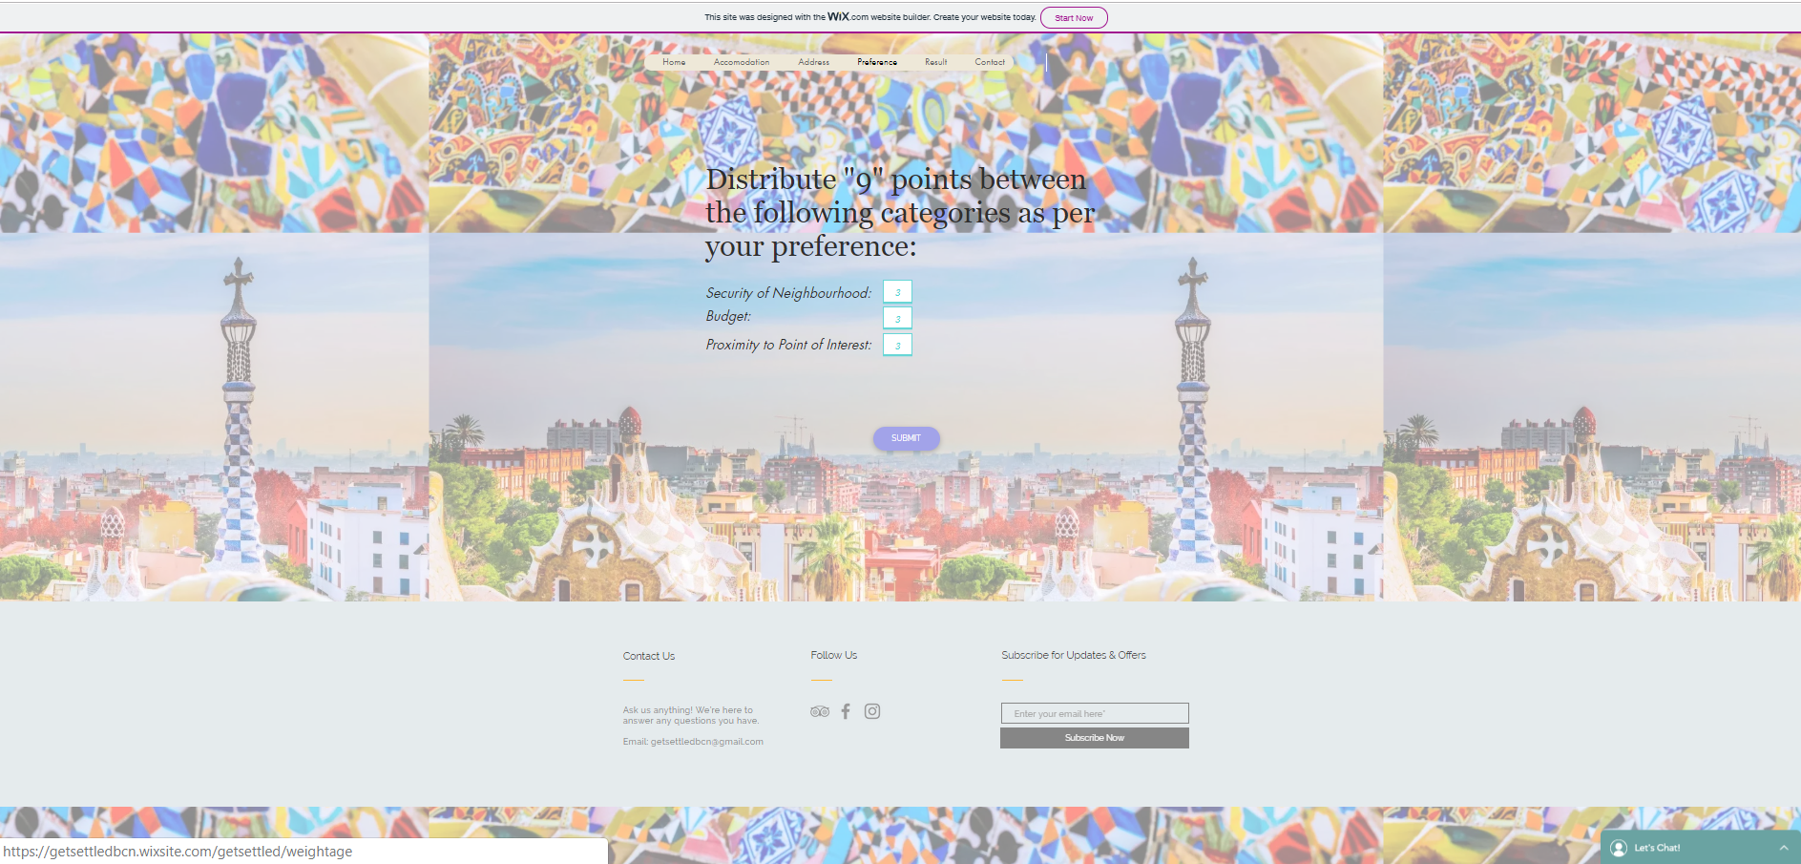
Si
Website design 4:

Slide 20
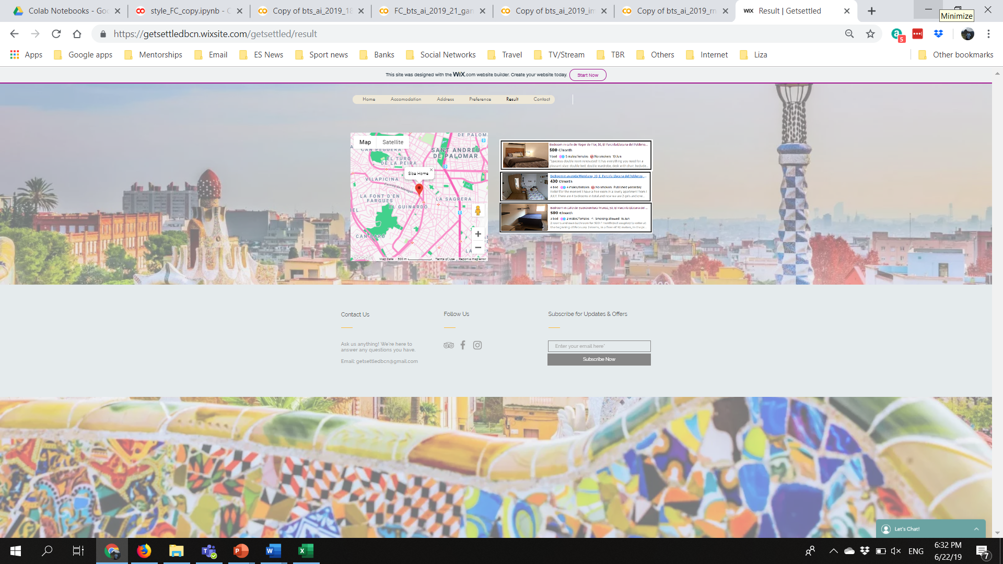
Si
Website design 5:

Slide 21


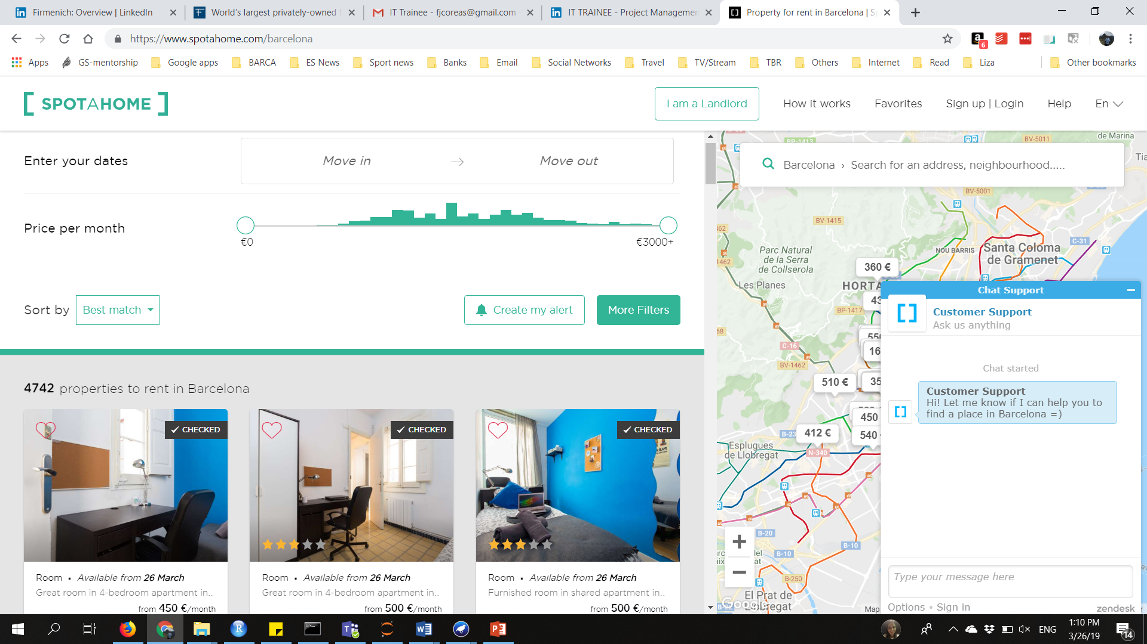
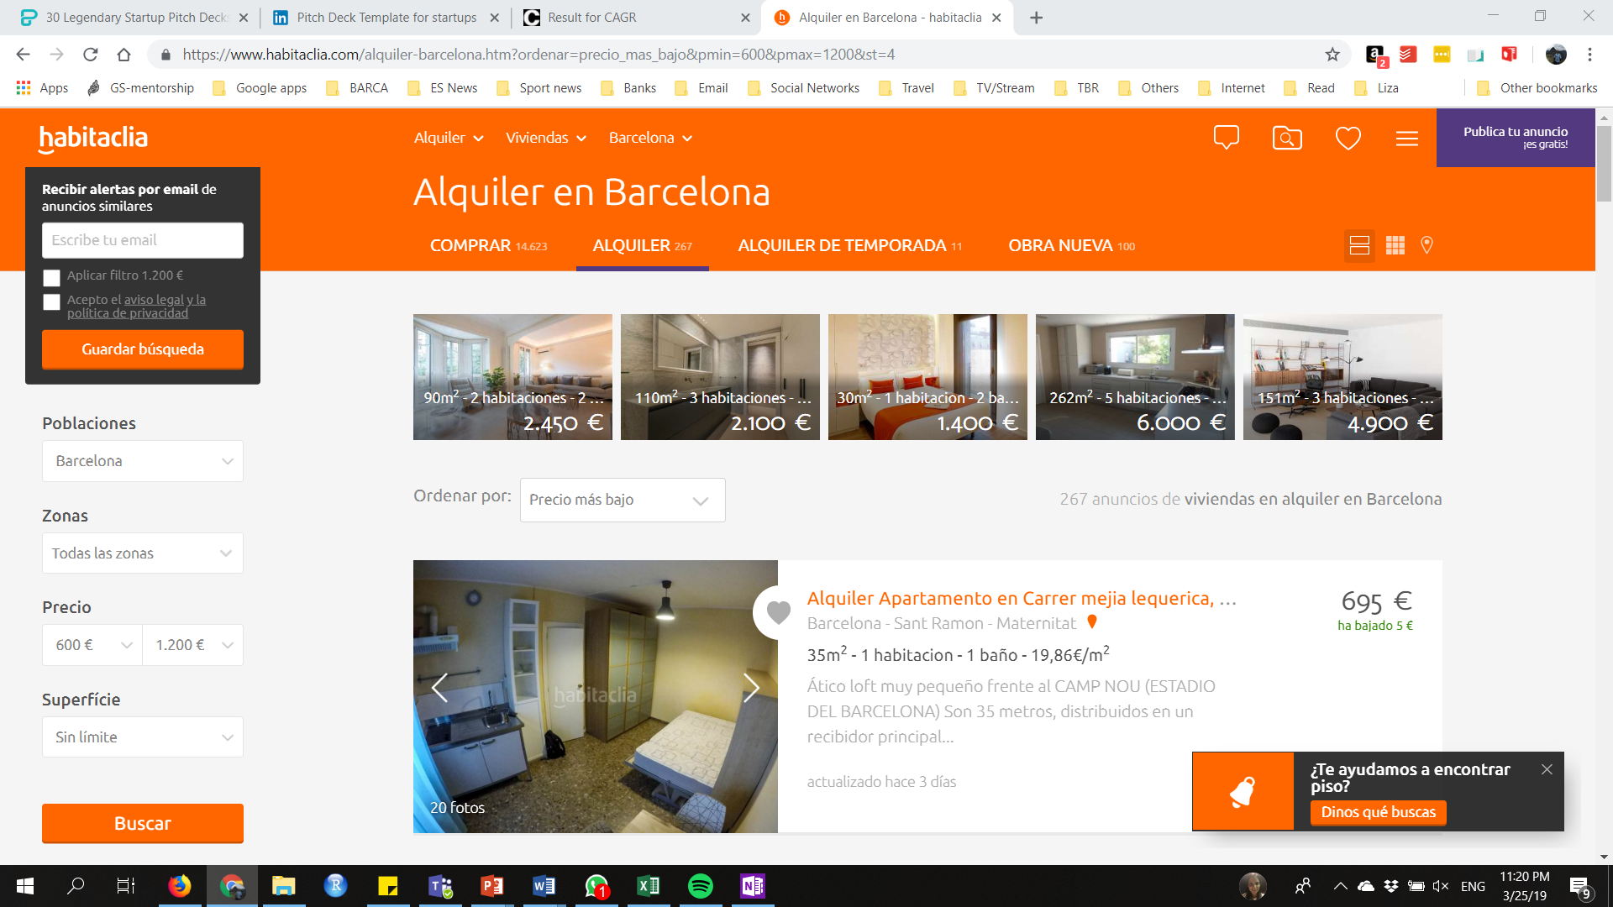
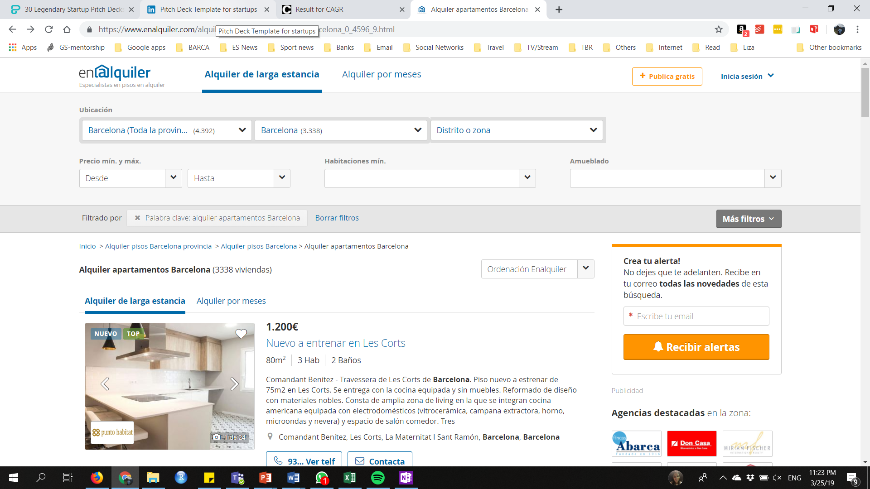
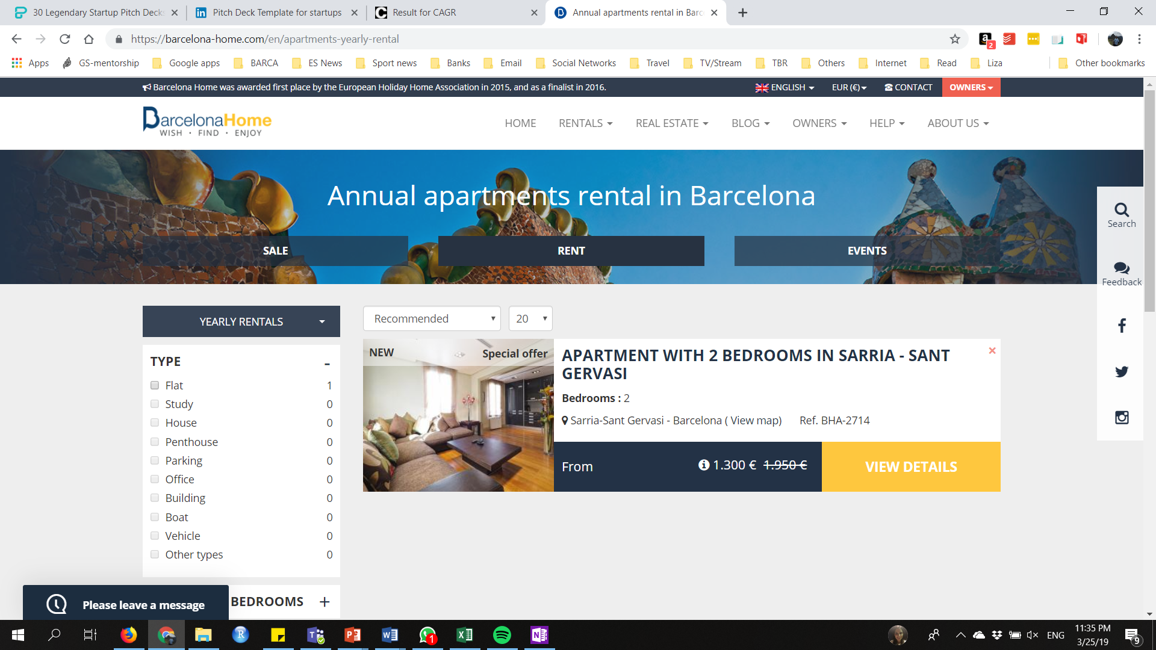

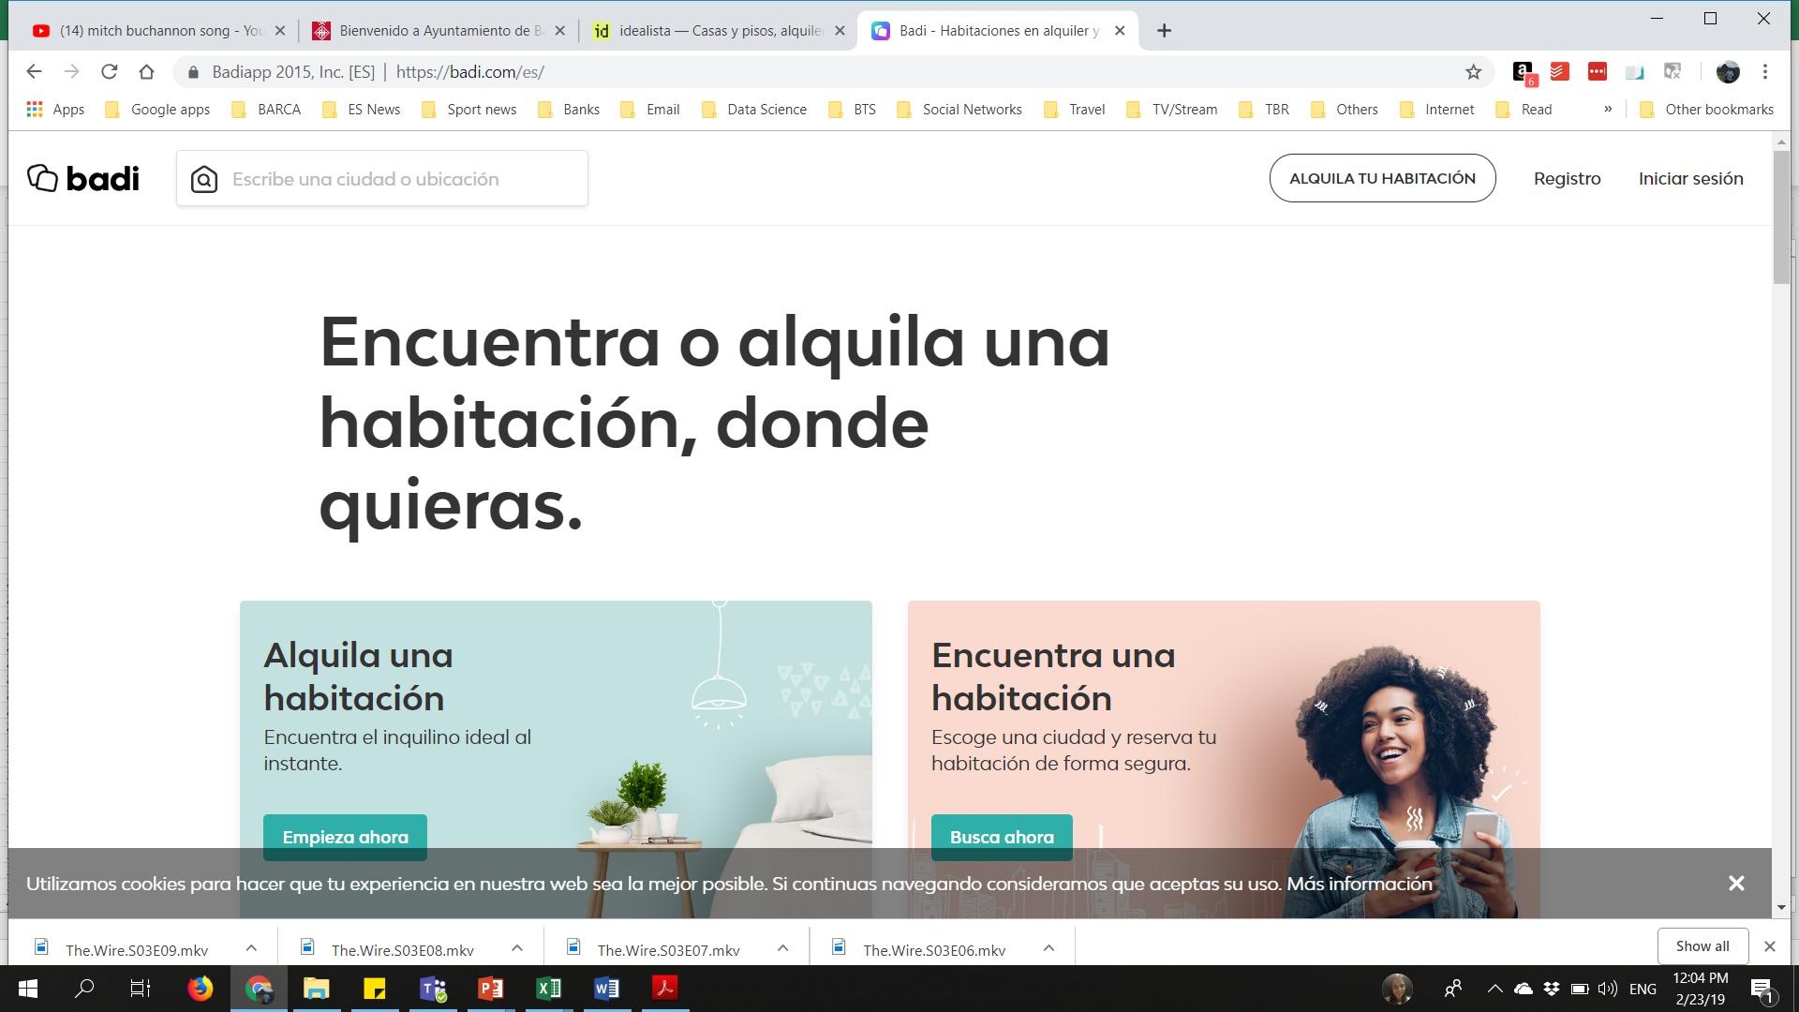




C
Future steps:
Lifestyle
Neighborhood Statistics
Collaborative Filtering
Events Newsletters
Scaling the service to other cities and for other types of users
Developing the Mobile Application
Value generation for Get Settled and to companies

Slide 22
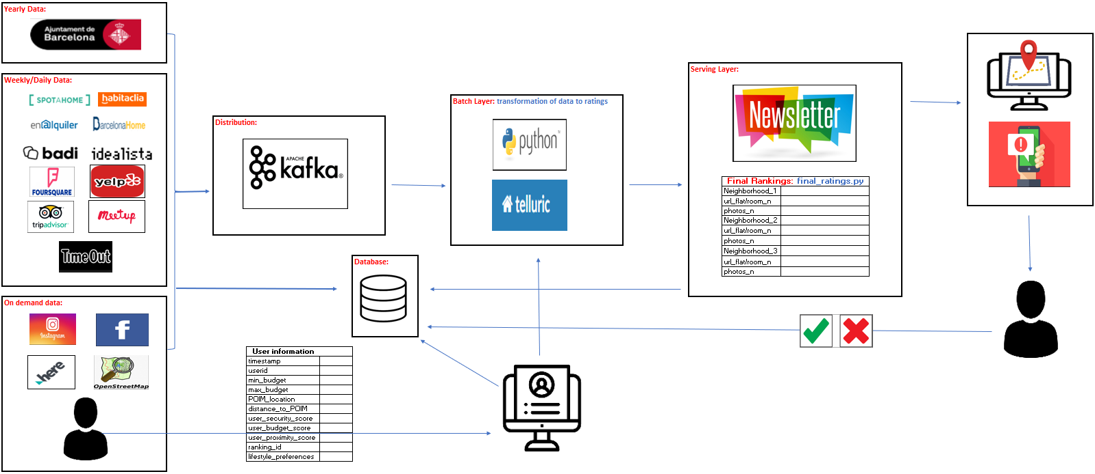
C
Data Infrastructure future GS:

Slide 23
Se
Felipe tests the service:
https://github.com/snat07/GetSettled
Input / Preferences:
POI Inputs
POI address: Almogavers 119
Time to POI: 10 minutes
Price Inputs:
property type: homes
Min price: €600.00
Max price: €1,300.00
Weights:
Distance weight: 5
Availability weight: 3
Security weight: 1

Slide 24
Felipe is happy:
https://github.com/snat07/GetSettled

